Slide 1

Oracle 11g: SQL
Chapter 1
Overview of Database Concepts
Data Models, ERD

Slide 2
Objectives
Determine a conceptual database design using
  Entity-relationship models ERM
  Entity-relationship diagrams ERD
Oracle 11g: SQL

Slide 3
Entity-Relationship Model
(E-R Model)
Used to depict the relationship that exists among entities
The following relationships can be included in an E-R model:
  One-to-one
  One-to-many
  Many-to-many
Oracle 11g: SQL

Slide 4
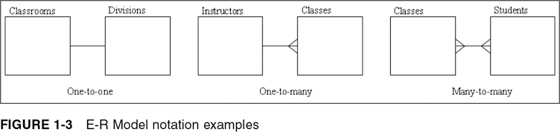
E-R Model Notation Examples
Oracle 11g: SQL

Slide 5
One-to-One Relationship
Each occurrence of data in one entity is represented by only one occurrence of data in the other entity
Example: Each individual has just one Social Security number (SSN) and each SSN is assigned to just one person
Oracle 11g: SQL

Slide 6
One-to-Many Relationship
Each occurrence of data in one entity can be represented by many occurrences of the data in the other entity
Example: A class has only one instructor, but each instructor can teach many classes
Oracle 11g: SQL

Slide 7
Many-to-Many Relationship
Data can have multiple occurrences in both entities
Example: A student can take many classes, and each class is composed of many students
Can not be included in the physical database
Oracle 11g: SQL

Slide 8
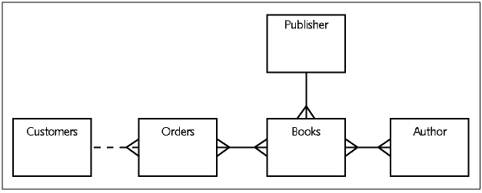
JustLee Example E-R Model
Oracle 11g: SQL

Slide 9
Chen Notation
Strong
entity
Attribute
Weak
entity
Multivalued
attribute
Derived
attribute
Relationship
Identifying
Relationship
Associative
entity

Slide 10
Entities
Strong entity type
An entity that can exist independently of other entity types
Weak entity type
An entity whose existence depends on some other entity type
  Identifying owner - the entity type on which a weak entity type depends
  Identifying relationship - the relationship between a weak entity type and its owner

Slide 11
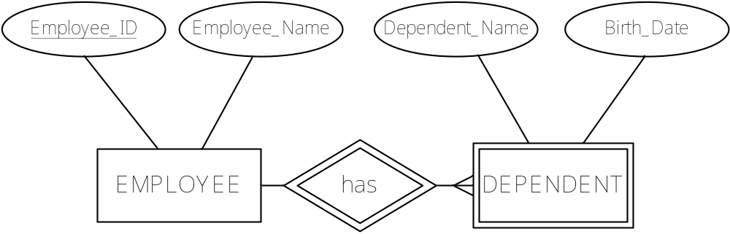
Entities
Notes:
Most CASE tools don’t show weak entities, indentifying relationships

Slide 12
Attributes
Simple Composite
Single-valued Multi-valued
Stored Derived
Notes:
Simple or Composite
Cannot or can be broken into smaller components
Single-valued or Multi-valued
Only one value or a set of many values for a given entity instance
Stored or Derived
Physically exists as a column or calculated on the fly from other columns
All any/all can be applicable:
Student Number = Simple, Single-valued, Stored
GPA = Simple, Single-valued, Derived
Address History = Composite, Multi-valued, Stored

Slide 13
Attributes
Street
City
Prov_State
Postal_Code
Employee_ID
Employee_Name
Address
EMPLOYEE
Skills
Years_Employed
Date_Employed

Slide 14
Relationships
Shown as a line connecting two entities
(optional diamond)
Degree = Number of entity types that participate
  binary (2), unary (1), ternary (3)
Connectivity / Multiplicity = Type of line end
  bar (1) crow’s foot (many)
Cardinality = Number of instances that can (or must) be associated
  Min usually 0, 1
  Max usually 1, fixed number, infinite

Slide 15
Relationships
Degree
Cardinality
Mandatory one
unary
Mandatory many
binary
Optional one
ternary
Optional many
Notes:
Degree = how many entity types
Cardinality = how many entity instances

Slide 16
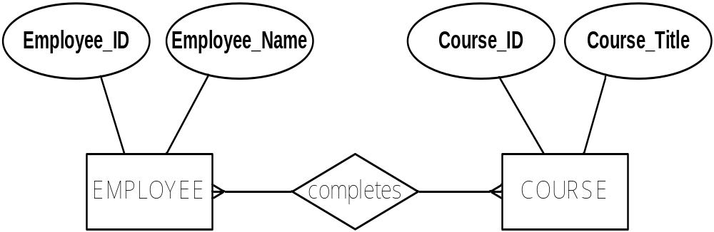
Relationships
many-many relationship type

Slide 17
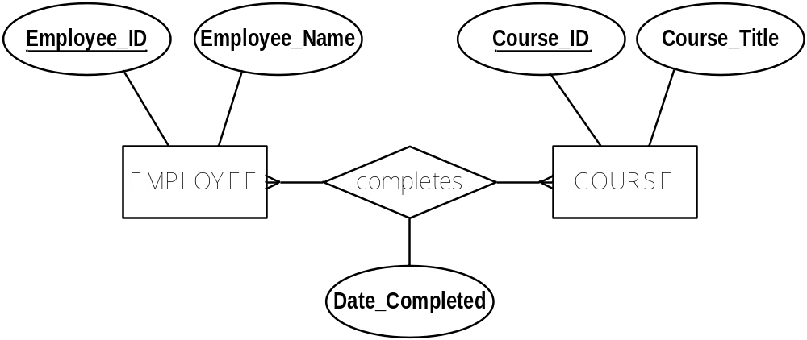
Relationships
Attributes can be on many-many or one-one relationships as well as on entities

Slide 18
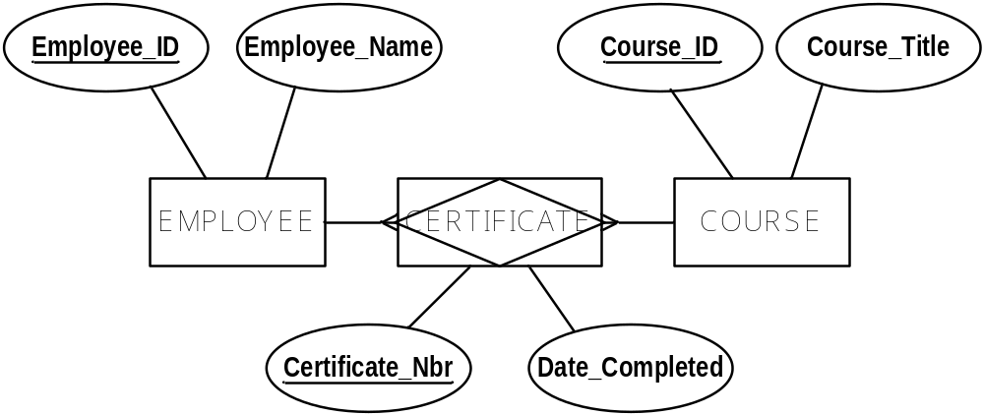
Associative Entity
An entity type that associates the instances of multiple entity types and contains attributes that are peculiar to the relationship between those entity types
Notes:
NOTE different direction of crows feet

Slide 19
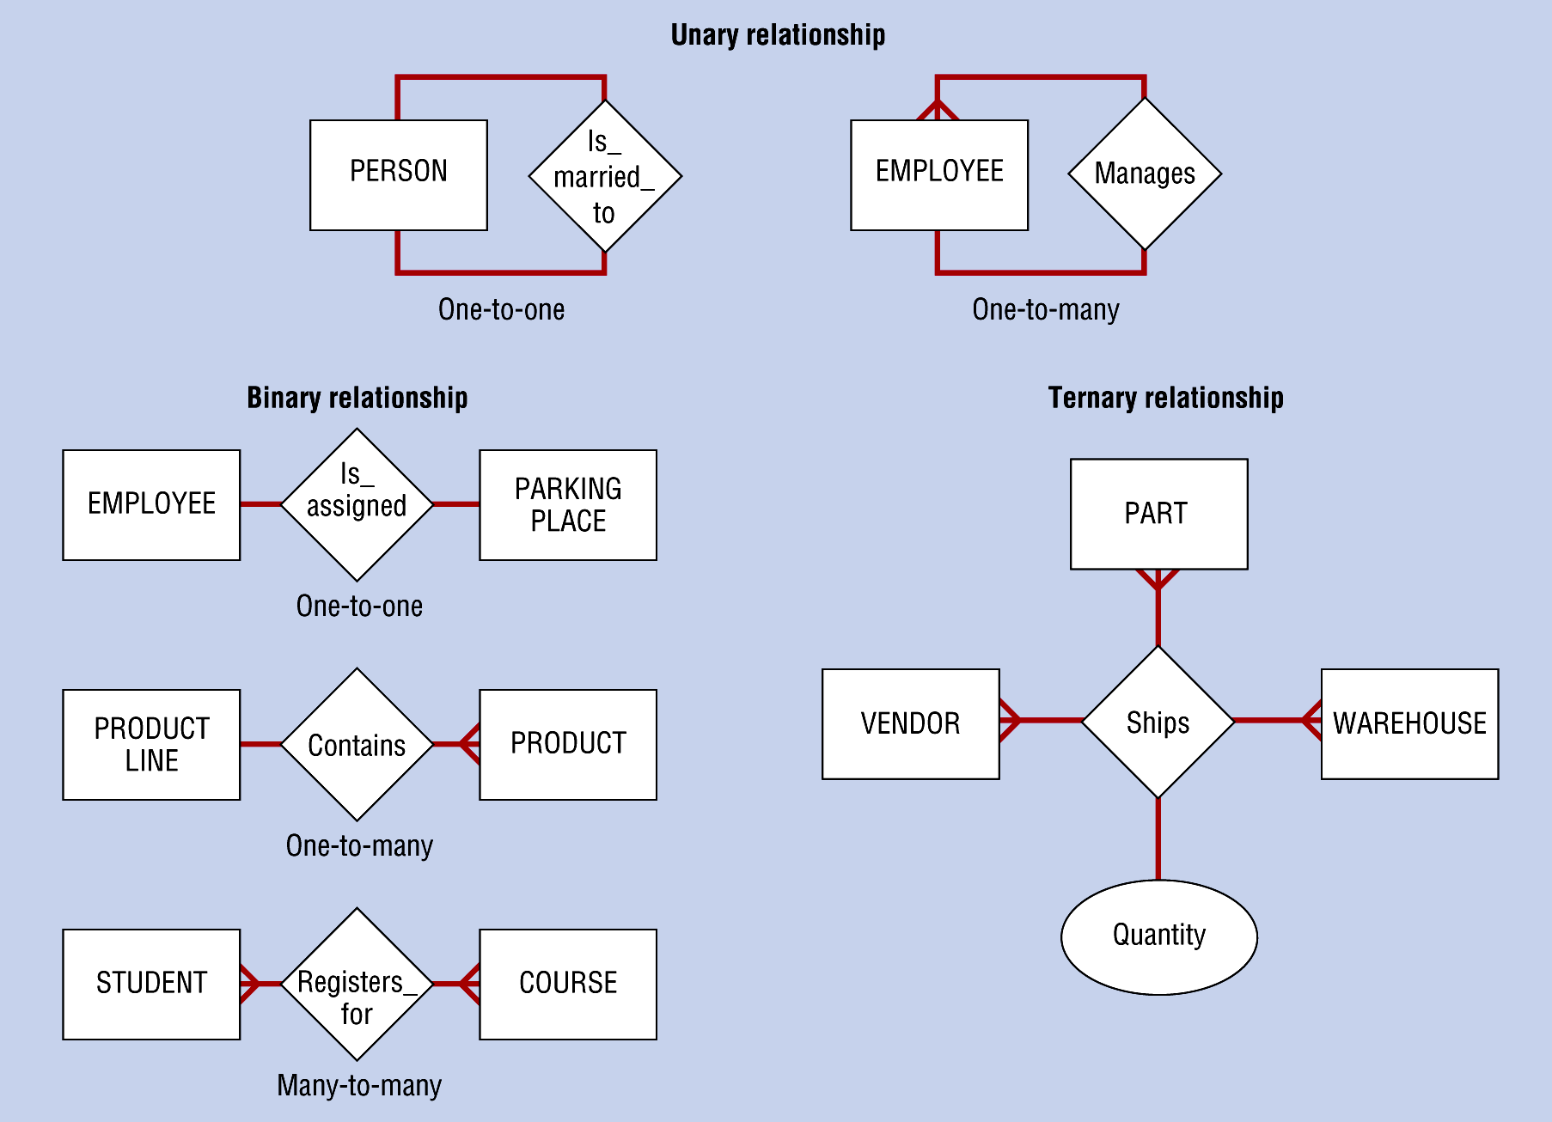
Relationship Degree
Binary
  Between the instances of two entity types
Notes:
most common – 95%

Slide 20
Relationship Degree
Unary
  Between two different instances of a single entity type (aka recursive)
Notes:
usually where you have people or things in hierarchies

Slide 21
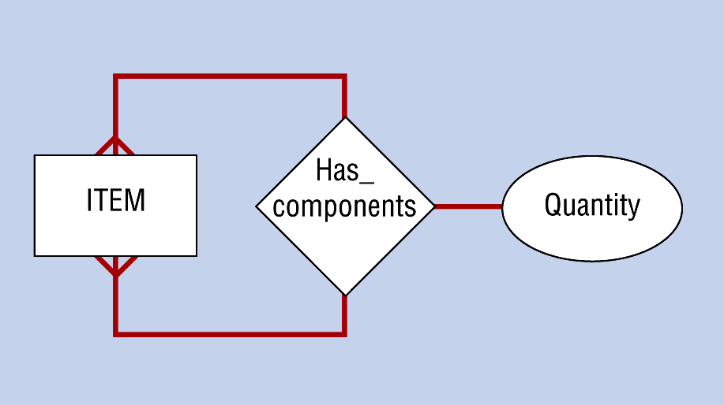
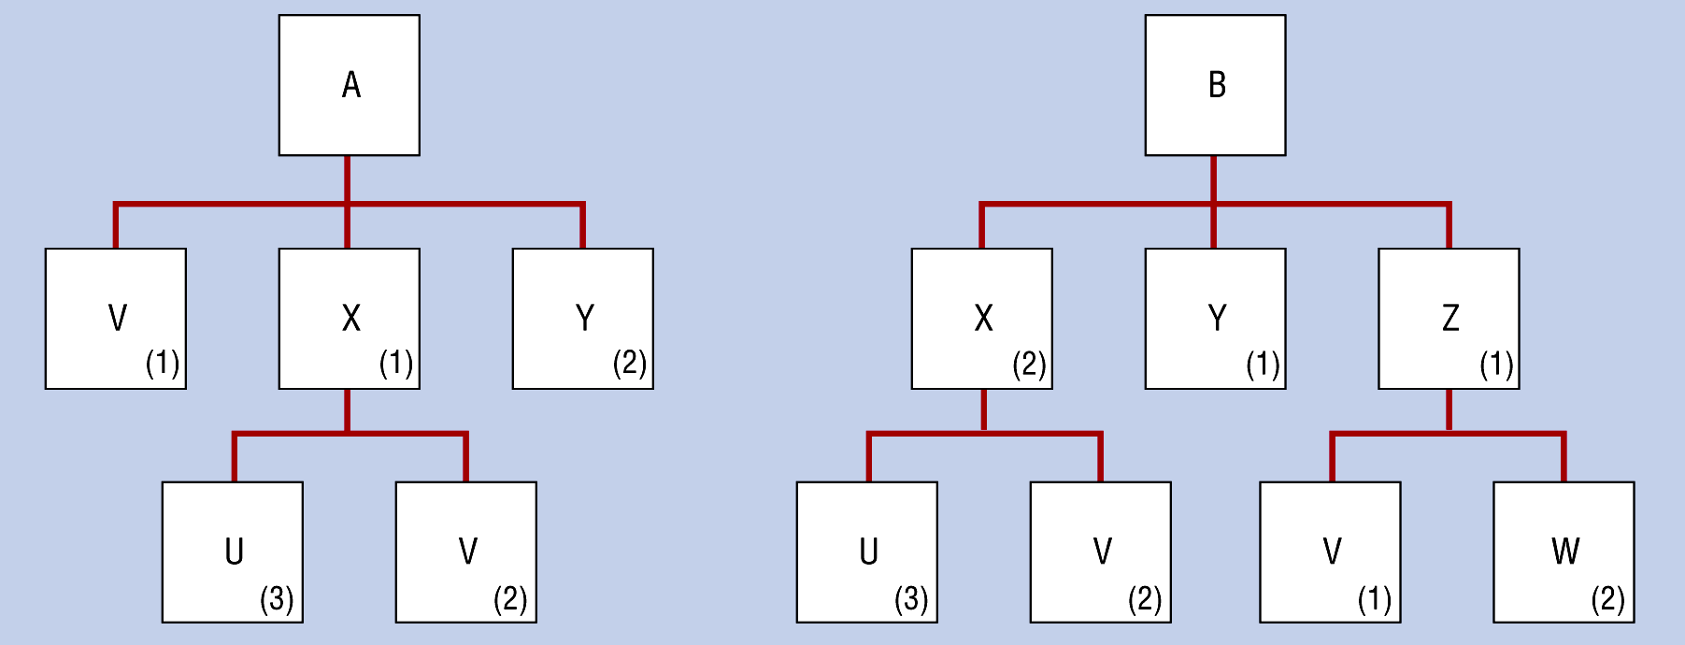
Relationship Degree
Unary many-many
  Bill Of Materials / Explosion Of Parts
(a) Many-to-Many Relationship
(b) Two Instances

Slide 22
Relationship Degree
Ternary
  Simultaneous relationship among the instances of three entity types
Notes:
“a vendor ships a quantity of a part to a warehouse”
Can conceptually have 4, 5, or even more – hard to wrap head around

Slide 23
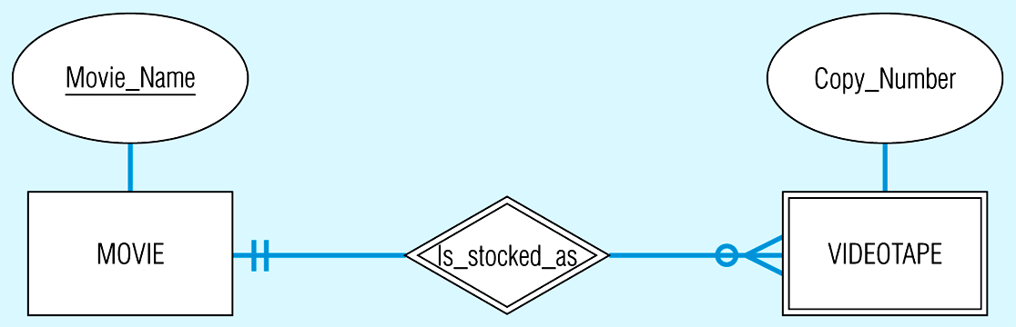
Relationship Cardinality
Optional = can have none
Mandatory = must have (at least) one

Slide 24
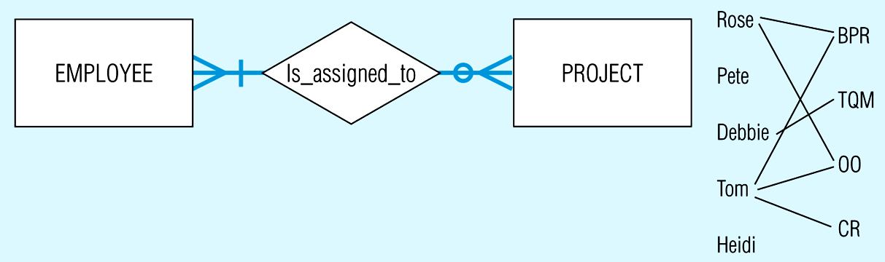
Relationship Cardinality
Minimum
  Smallest number of instances that can (may) be associated (usually 0 or 1)
Maximum
  Largest number of instances that can (may) be associated (usually 1 or n)
  Use ‘crows foot’ if more than 1
Notes:
Note every project must have an employee
Not every employee has a project

Slide 25
Relationship Cardinality
Business rules can affect cardinality:
A department must have a minimum of 10 employees and a maximum of 25 employees
A lab section must have at least 5 students (to utilize instructor’s time) and at most 35 (limit of how many PC’s in the room)
A student in high school, a must take at least 1 course and at most 4 courses in a semester
Notes:
(10,25)
(5,35)
(1,4)

Slide 26
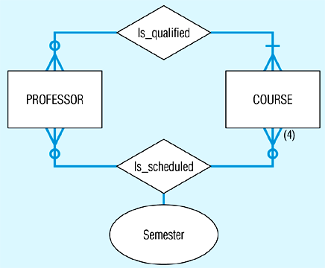
Multiple Relationships
Notes:
Note does not easily illustrate the business rule
“an instructor who is scheduled to teach a course must be qualified to teach that course”

Slide 27
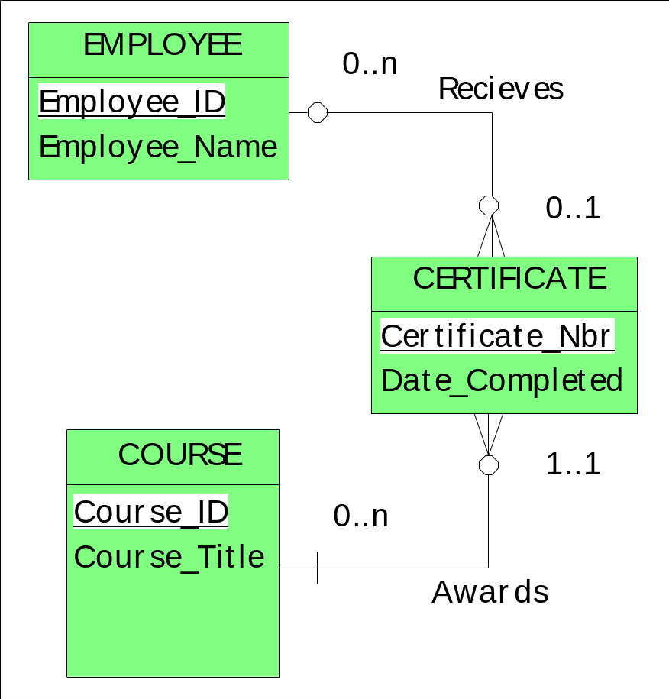
CASE tool notation
Chen notation is awkward to use in practise (attributes get in the way)
Most modern tools use a notation like
Notes:
Note CERTIFICATE as a data table will contain Course_ID and Employee_ID as columns but we do NOT show these on an ERD … they are implicit by having the relationship!

